Slide 1
Module 1
Anupama V
Assistant Professor

Slide 2
Optoelectronic Devices
Study of devices that emit, detect and control light in the wavelength spectrum ranging from ultraviolet to far infrared
Includes
Electrical-to-optical transducers
Optical-to-electrical transducers

Slide 3
Photodiode
Light detector semiconductor device that converts light energy into electric current or voltage which depends upon the mode of operation
Upper cut-off wavelength 𝜆𝑐=1240/𝐸𝑔
(𝐸𝑔 - bandgap energy)

Slide 4
p-n junction diode
Under reverse bias, a small amount of electric current generated due to minority charge carriers
Application of external reverse voltage to the p-n junction diode will not increase the population of minority charge carriers
Reason: Minority carriers generated at n-side or p-side will recombine in the same material, before they cross the junction
No electric current flows.

Slide 5
Photodiode
Apply external energy directly to the depletion region to generate more charge carriers
Photodiode is designed to generate more number of charge carriers in depletion region
Light or photons as the external energy to generate charge carriers in depletion region

Slide 6
Photodiode : Construction
ion implantation : surface of a layer of N-type is bombarded with P- type silicon ions to produce a P-type layer
Diffusion : excess electrons move from N-type towards P-type and excess holes move from P-type towards N-type
Results in the removal of free charge carriers close to the PN-junction, so creating a depletion layer

Slide 7
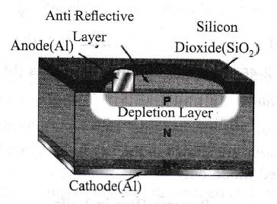
Photodiode : Construction

Slide 8
Photodiode : Construction
Silicon Dioxide (SiO2) in which there is a window for light to shine on the semiconductor.
Silicon Nitride (SiN) to allow maximum absorption of light
An anode connection of aluminium (AI) is provided to the P-type layer
A more heavily doped N+ layer to provide a low resistance connection to the cathode

Slide 9
Photodiode : Working Principle
The junction of Photodiode is illuminated by the light source; the photons strike the junction surface.
The photons impart their energy in the form of light to the junction.
Due to which electrons from valence band get the energy to jump into the conduction band.
This leaves positively charged holes in the valence band, so producing 'electron-hole pairs' in the depletion layer.

Slide 10
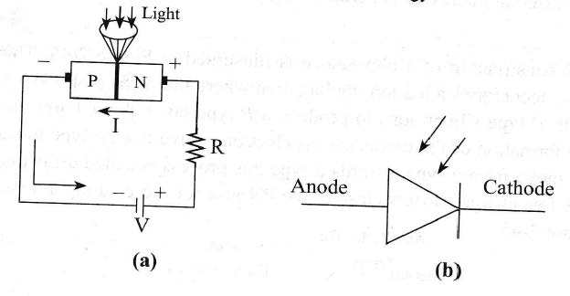
Photodiode : Working Principle

Slide 11
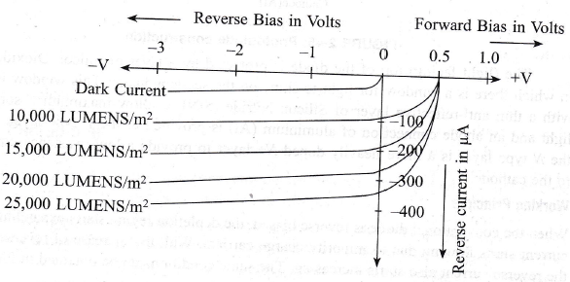
Photodiode: V-I Characteristics
Reverse bias current is the summation of reverse saturation current and short circuit current.

Slide 12
Photodiode : Applications
Consumer electronics devices like smoke detectors, compact disc players, and televisions and remote controls in VCRs.
Photodiodes are frequently used for exact measurement of the intensity of light in science and industry.

Slide 13
Light Emitting Diode (LED)
The LED is a PN-junction diode which emits light when an electric current passes through it in the forward direction
Electroluminescence is the properly of the material to convert electrical energy into light energy

Slide 14
LED : Construction
The semiconductor material used in LED is Galliurn Arsenide (GaAs), Gallium phosphide (GaP) or Gallium Arsenide Phosphide (GaAsP).
The semiconductor layer of P-type is placed above N-type because the charge carrier recombination occurs in P-type.
If P-type is placed below the N-type, the emitted light cannot be seen.

Slide 15
LED : Construction
The semiconductor material used in LED is Galliurn Arsenide (GaAs), Gallium phosphide (GaP) or Gallium Arsenide Phosphide (GaAsP).
The semiconductor layer of P-type is placed above N-type because the charge carrier recombination occurs in P-type.

Slide 16
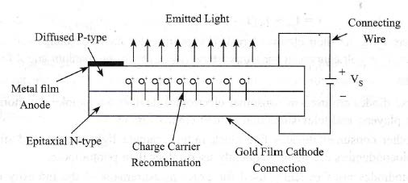
LED : Construction

Slide 17
LED : Construction
The P-type layer is formed from diffusion of semiconductor material.
The metal film is used on the P-type layer to provide anode connection to the diode.
Gold-film layer is coated on N-type to provide cathode connection. The Gold-film layer on N-type also provides reflection from the bottom surface of the diode.
If any significant part of radiated light tends to hit bottom surface then that will be reflected from the bottom surface to the device top surface. This increases LED's efficiency.

Slide 18
LED : Working Principle
The charge carriers recombine in a forward-biased P-N junction as the electrons cross from the N-region and recombine with the holes existing in the P-region.
Free electrons are in the conduction band of energy levels
Holes are in the valence energy band.
Energy level of the holes is less than the energy levels of the electrons.
Some portion of the energy must be dissipated to recombine the electrons and the holes. This energy is emitted in the form of heat and light.

Slide 19
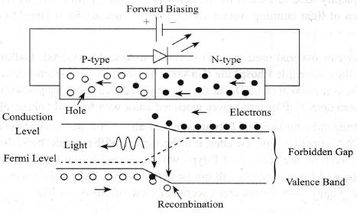
LED : Working Principle

Slide 20
LED : Working Principle
Electron emit electromagnetic energy in the form of photons.
The energy of photons is equal to the gap between the valence and the conduction band.
Color of light can be determined by the band gap of semiconductor material.

Slide 21
LED : Applications
LEDs are used in remote control systems such TV or LCD remote.
Used in traffic signals for controlling the traffic crowds in cites.
Used in digital computers for displaying the computer data.
Used in electronic calculators for showing the digital data.
Used in digital watches and automotive heat lamps.

Slide 22
Photocoupler
Photocoupler or Optocoupler is a device that transfers electrical signals between two isolated circuits by using light.

Slide 23
Photocoupler : Construction
All optocouplers consist of two elements: a light source (a LED) and a photosensor (a photoresistor, photodiode, phototransistor, silicon-controlled rectifier (SCR), or triac); which are separated by a dielectric (non-conducting) barrier

Slide 24
Photocoupler : Working
When input current is applied to the LED, it switches ON and emits infrared light
The photosensor then detects this light and allows current to flow through the output side of the circuit
When the LED is off, no current will flow through the photosensor.
By this method, the two flowing currents are electrically isolated. It consists of LED and photodiode; where the circuits are isolated electrically.
In the following Figure, LED is forward biased, photodiode is reverse biased and output exists across R2.

Slide 25
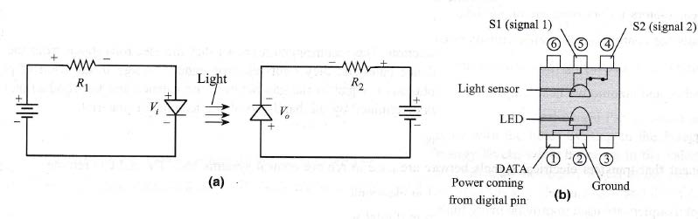
Photocoupler : Working

Slide 26
Photocoupler : Applications
Input and output switching in electronically noisy environments.
Controlling transistors and triacs.
Switch-mode power supplies.
PC/ Modem communication.
Signal isolation.
Power control.

Slide 27
BJT BIASING
A transistor (Bipolar Junction Transistor-BJT) is a sandwich of one type of semiconductor (P-type or N-type) between two layers of other type.
Three types of biasing a transistor:
Base bias or Fixed bias,
Collector-to-Base bias,
Voltage-divider bias.

Slide 28
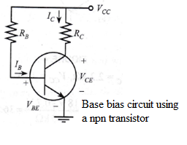
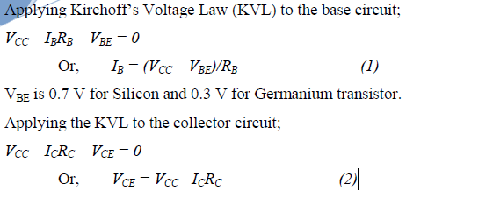
BASE BIAS or FIXED BIAS:

Slide 29
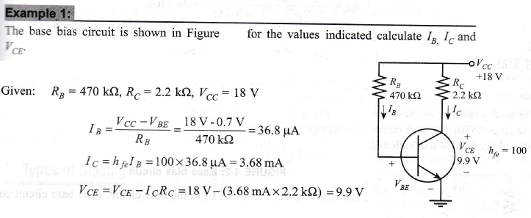

Slide 30
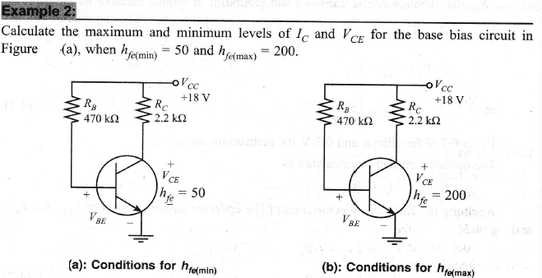

Slide 31
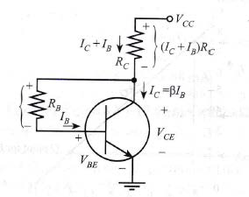
COLLECTOR-TO-BASE BIAS CIRCUIT:

Slide 32
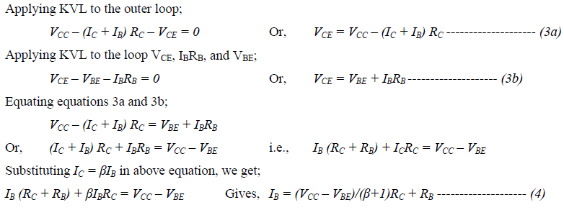
COLLECTOR-TO-BASE BIAS CIRCUIT:

Slide 33
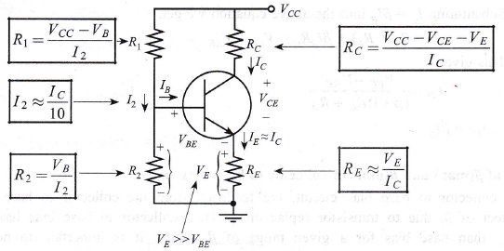
VOLTAGE DIVIDER (EMITTER CURRENT) BIAS CIRCUIT:

Slide 34
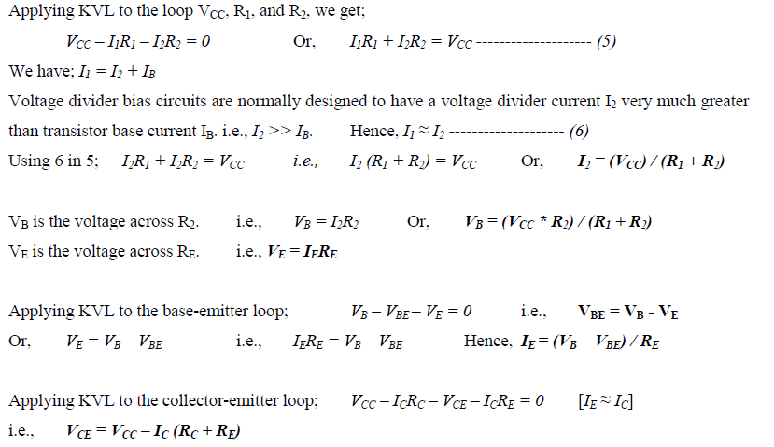
VOLTAGE DIVIDER /EMITTER CURRENT BIAS CIRCUIT:

Slide 35
MULTIVIBRATORS USING IC-555
A multivibrator circuit oscillates between a “HIGH” state and a “LOW” state producing a continuous output.
It generates square, rectangular, pulse waveforms, also called nonlinear oscillators or function generators.
There are basically three types of clock pulse generation circuits:
Astable – A free-running multivibrator that has NO stable states but switches continuously between two states this action produces a train of square/rectangular wave pulses at a fixed frequency.
Monostable – A one-shot multivibrator that has only ONE stable state and is triggered externally with it returning back to its first stable state.
Bistable – A flip-flop that has TWO stable states that produces a single pulse either positive or negative in value.

Slide 36
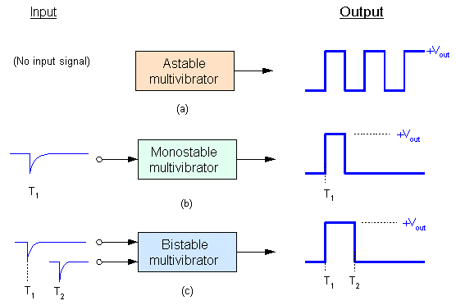
MULTIVIBRATORS USING IC-555

Slide 37
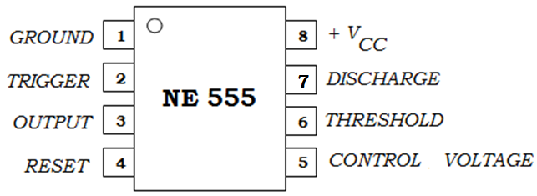
Integrated Circuit(IC) Multivibrators
The NE555 (also LM555, CA555) is a widely used IC timer, a circuit that can run in either of two modes: monostable (one stable state) or astable (no stable states).

Slide 38
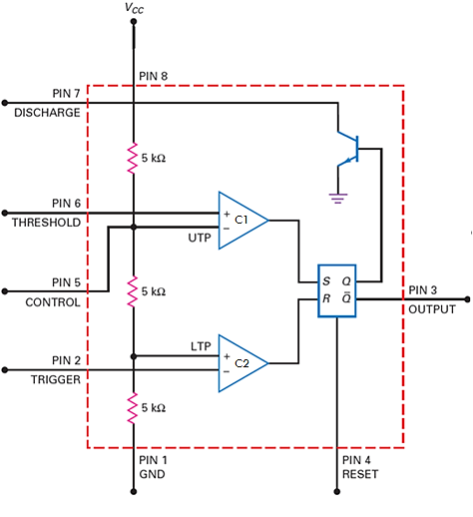
Integrated Circuit(IC) Multivibrators

Slide 39
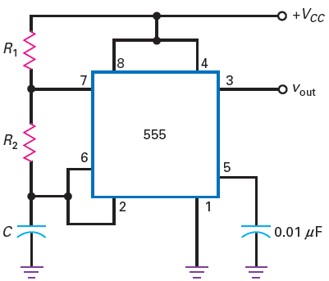
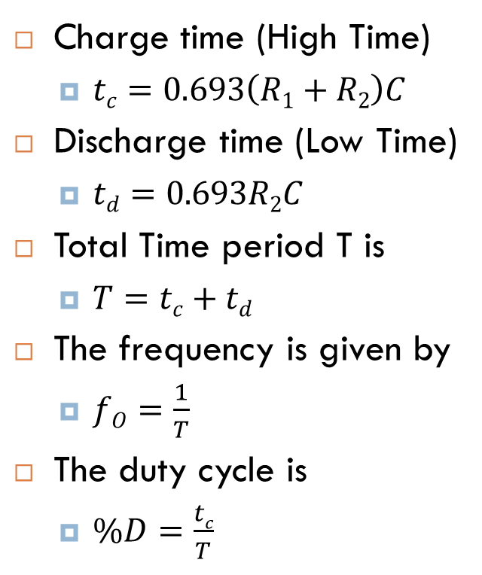
Integrated Circuit(IC) Multivibrators Astable Operation of the 555 Timer
Circuit Diagram
Charge time (High Time)
$tc=0.693\left(R1+R2\right)C$
Discharge time (Low Time)
$td=0.693R2C$
Total Time period T is
$T=tc+td$
The frequency is given by
$fO=\frac{1}{T}$
The duty cycle is
$\%D=\frac{tc}{T}$

Slide 40
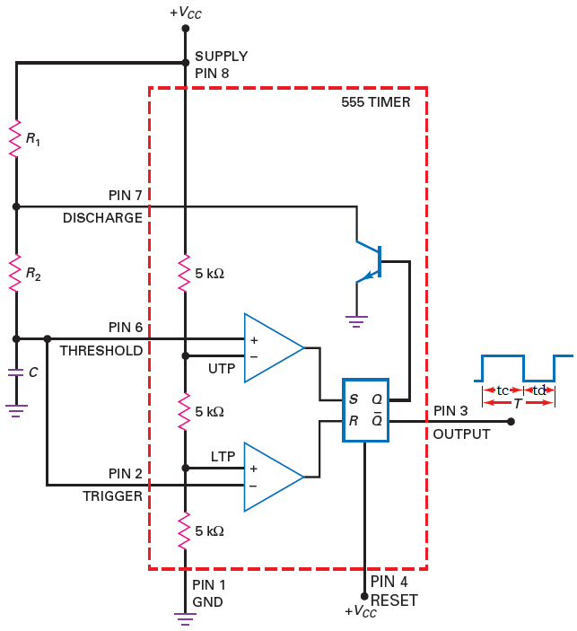
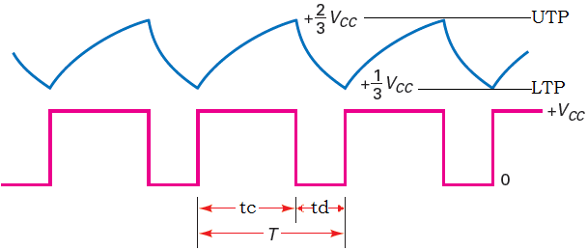
Integrated Circuit(IC) Multivibrators Astable Operation of the 555 Timer
Capacitor and output waveforms

Slide 41
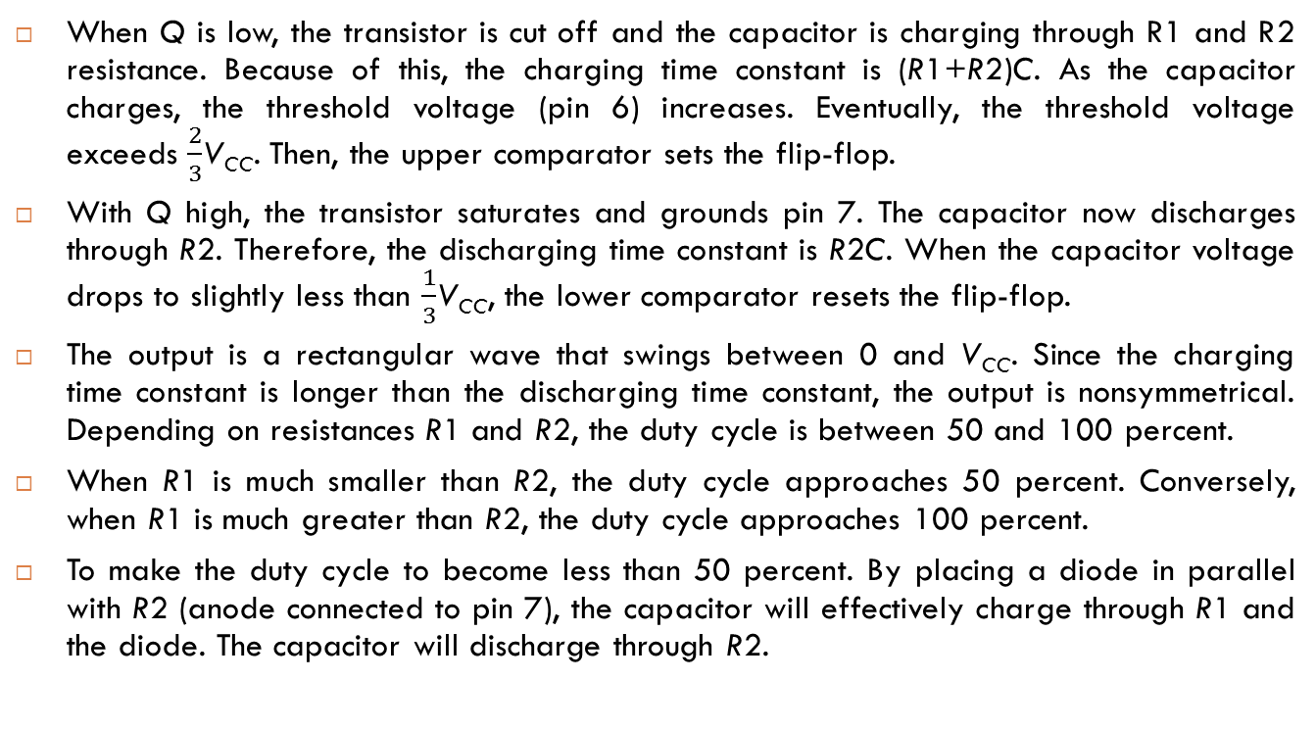
Integrated Circuit(IC) Multivibrators Astable Operation of the 555 Timer
When Q is low, the transistor is cut off and the capacitor is charging through R1 and R2 resistance. Because of this, the charging time constant is (R1+R2)C. As the capacitor charges, the threshold voltage (pin 6) increases. Eventually, the threshold voltage exceeds $\frac{2}{3}$V_{CC}. Then, the upper comparator sets the flip-flop.
With Q high, the transistor saturates and grounds pin 7. The capacitor now discharges through R2. Therefore, the discharging time constant is R2C. When the capacitor voltage drops to slightly less than $\frac{1}{3}$V_{CC}, the lower comparator resets the flip-flop.
The output is a rectangular wave that swings between 0 and V_{CC}. Since the charging time constant is longer than the discharging time constant, the output is nonsymmetrical. Depending on resistances R1 and R2, the duty cycle is between 50 and 100 percent.
When R1 is much smaller than R2, the duty cycle approaches 50 percent. Conversely, when R1 is much greater than R2, the duty cycle approaches 100 percent.
To make the duty cycle to become less than 50 percent. By placing a diode in parallel with R2 (anode connected to pin 7), the capacitor will effectively charge through R1 and the diode. The capacitor will discharge through R2.

Slide 42
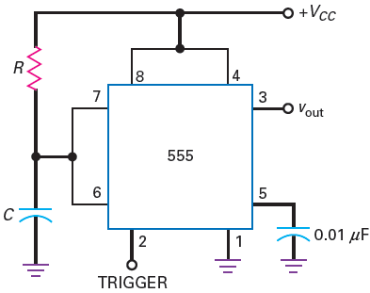
Integrated Circuit(IC) Multivibrators Monostable Operation of the 555 Timer
Circuit Diagram
Pulse Width is
W=1.1RC
The circuit has an external resistor R and a capacitor C.
The voltage across the capacitor is used for the threshold voltage to pin 6.
When the trigger arrives at pin 2, the circuit produces a rectangular output pulse from pin 3.

Slide 43
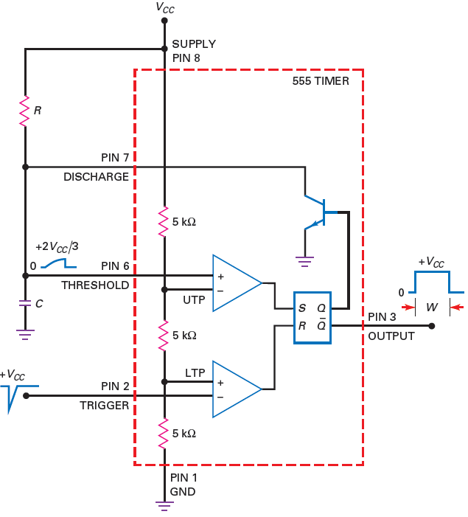
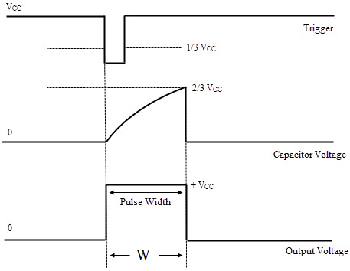
Integrated Circuit(IC) Multivibrators Monostable Operation of the 555 Timer

Slide 44
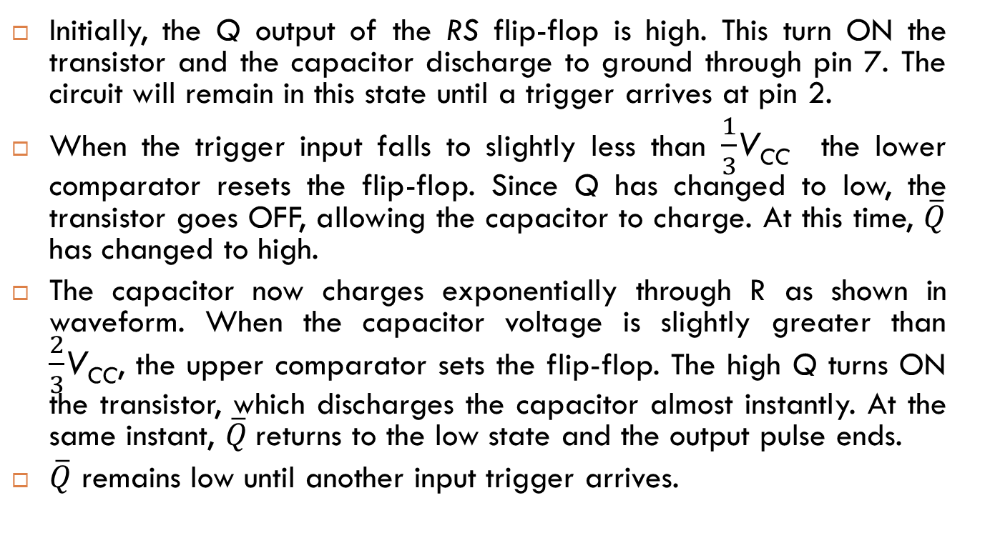
Integrated Circuit(IC) Multivibrators Monostable Operation of the 555 Timer
Initially, the Q output of the RS flip-flop is high. This turn ON the transistor and the capacitor discharge to ground through pin 7. The circuit will remain in this state until a trigger arrives at pin 2.
When the trigger input falls to slightly less than $\frac{1}{3}$V_{CC}the lower comparator resets the flip-flop. Since Q has changed to low, the transistor goes OFF, allowing the capacitor to charge. At this time, $\overline{Q}$has changed to high.
The capacitor now charges exponentially through R as shown in waveform. When the capacitor voltage is slightly greater than $\frac{2}{3}$V_{CC}, the upper comparator sets the flip-flop. The high Q turns ON the transistor, which discharges the capacitor almost instantly. At the same instant, $\overline{Q}$returns to the low state and the output pulse ends.
$\overline{Q}$remains low until another input trigger arrives.

Slide 45
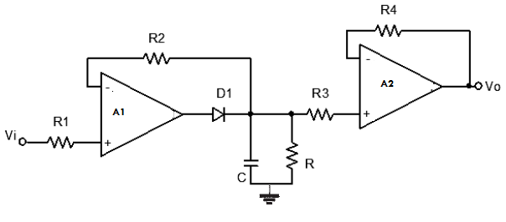
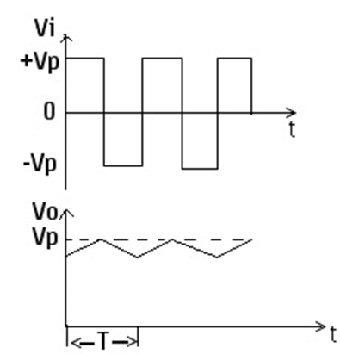

Peak Detector Circuit
RC ≥ 10 T

Slide 46
Peak Detector Circuit
During +ve half cycle when the input voltage is positive, the diode is conducting/ON and capacitor charges to the peak of the input voltage.
Second, when the input voltage is negative during –ve half cycle, the diode is non-conducting/OFF and the capacitor discharges through the load resistor.
As long as the discharging time constant is much greater than the period of the input signal (T), the output voltage will be approximately equal to the peak value of the input voltage.
This can achieved by making discharging time constant RC can be made much longer than the period of the input signal (RC ≥ 10 T), will get almost perfect peak detection of low-level signals.
If the peak-detected signal has to drive a small load, to avoid loading effects by connecting the voltage follower (op-amp buffer) isolates the small load resistor from the peak detector. This prevents the small load resistor from discharging the capacitor too quickly.

Slide 47
Comparator
Comparator circuit compares a single voltage on one input of op-amp with a known voltage called reference voltage (Trip point or trigger point) on the other input and produces high or low output depending upon relative magnitude of two input.
Comparators with Zero Reference
Comparators with Nonzero References
Comparators with Hysteresis or Schmitt Trigger
Window Comparator

Slide 48
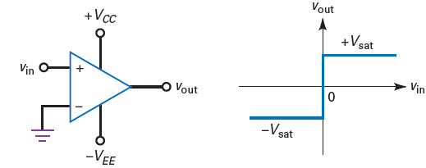
Comparators with Zero Reference
Non-Inverting Comparator
Because of the high open-loop voltage gain, a positive input voltage produces positive saturation, and a negative input voltage produces negative saturation.
Above circuit is called a zero-crossing detector because the output voltage ideally switches from low to high or vice versa whenever the input voltage crosses zero (input compares with zero reference voltage).

Slide 49
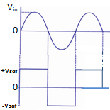
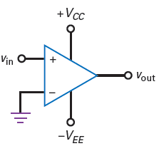
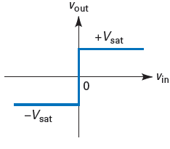
Comparators with Zero Reference
Non-Inverting Comparator

Slide 50
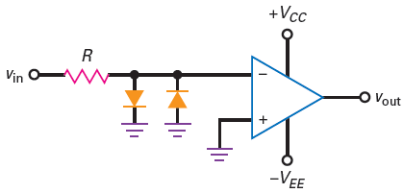
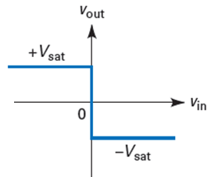
Comparator Comparators with Zero Reference
Inverting Comparator
The input signal drives the inverting input of the comparator. In this case, a positive input voltage produces a maximum negative saturation, as shown in above diagram. On the other hand, a negative input voltage produces a maximum positive saturation.

Slide 51
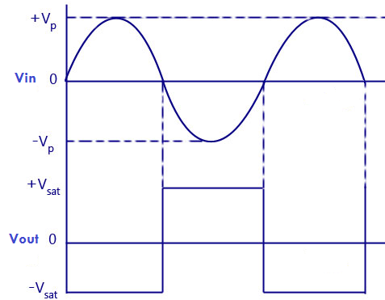
Comparators with Zero Reference
Inverting Comparator

Slide 52
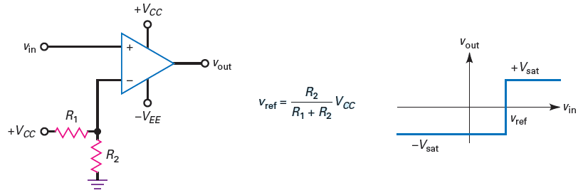
Comparators with Nonzero References
Non-Inverting Comparator: Positive reference
When Vin is greater than Vref, the differential input voltage is positive and the output voltage is high (+Vsat). When Vin is less than Vref, the differential input voltage is negative and the output voltage is low (-Vsat).
Vin > Vref then Vout = +Vsat
Vin < Vref then Vout = - Vsat

Slide 53
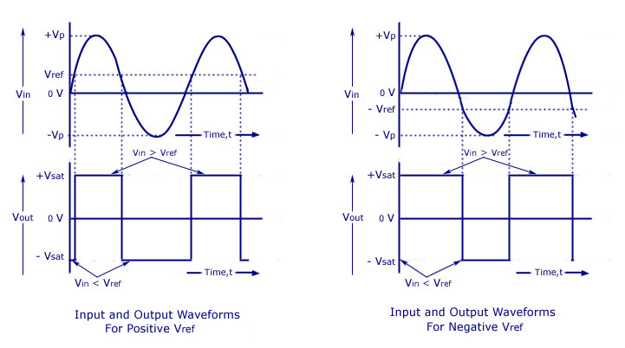
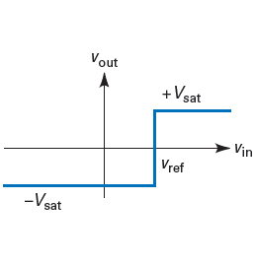
Comparators with Nonzero References
Non-Inverting Comparator: Positive reference

Slide 54
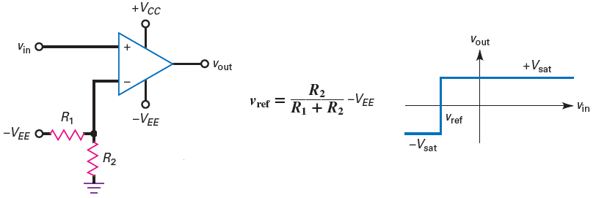
Comparators with Nonzero References
Non-Inverting Comparator: Negative reference
Vin > Vref then Vout = + Vsat
Vin < Vref then Vout = - Vsat

Slide 55
Comparators with Nonzero References
Non-Inverting Comparator: Negative reference

Slide 56
Comparators with Hysteresis /Schmitt Trigger
Inverting Schmitt trigger
When the comparator is positively saturated, a positive voltage is fed back to the noninverting input. This positive feedback voltage holds the output in the high state.
Similarly, when the output voltage is negatively saturated, a negative voltage is fed back to the noninverting input, holding the output in the low state.

Slide 57
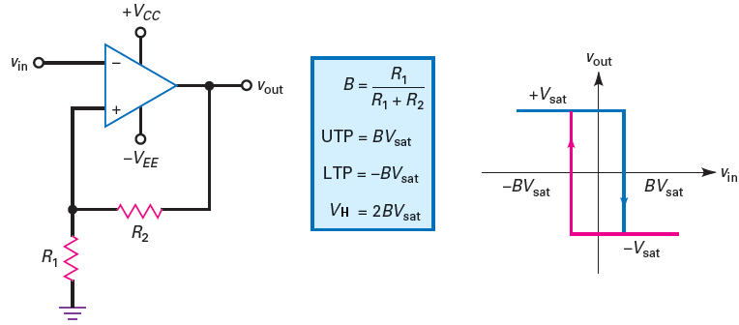
Schmitt Trigger
Inverting Schmitt trigger

Slide 58
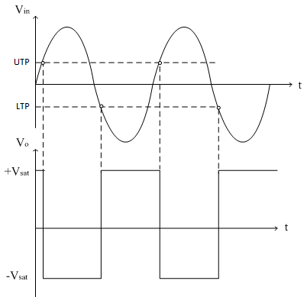

Schmitt Trigger
Inverting Schmitt trigger

Slide 59
Schmitt Trigger
Inverting Schmitt trigger
The output voltage will remain in a given state until the input voltage exceeds the reference voltage for that state.
For instance, if the output is positively saturated, the reference voltage is +BVsat. The input voltage must be increased to slightly more than +BVsat to switch the output voltage from positive to negative, as shown in input/output response has hysteresis.
Once the output is in the negative state, it will remain there indefinitely until the input voltage becomes more negative than -BVsat. Then, the output switches from negative to positive shown in input/output response has hysteresis.

Slide 60
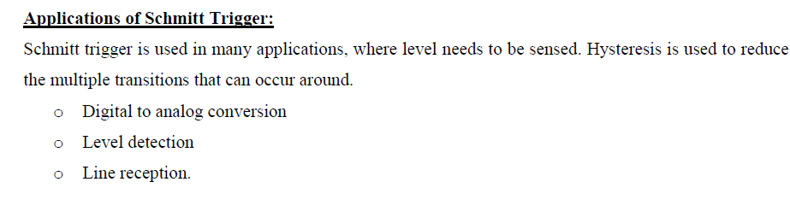
Schmitt Trigger

Slide 61
Window Comparator
An ordinary comparator indicates when the input voltage exceeds a certain limit or threshold.
A window comparator (also called a double-ended limit detector) detects when the input voltage is between two limits called the window. To create a window comparator, will use two comparators with different thresholds.

Slide 62
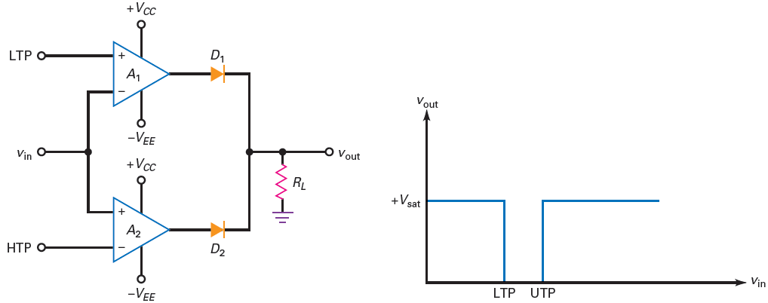
Window Comparator
Low Output between Limits

Slide 63
Window Comparator
Low Output between Limits
Circuit shows a window comparator that can produce a low output voltage when the input voltage is between a lower and an upper limit.
When Vin is less than LTP or greater than UTP, the output is high. When Vin is between LTP and UTP, the output is low.
Operation:
When Vin < LTP, comparator A1 has a positive output and A2 has a negative output. Diode D1 is on and D2 is off. Therefore, the output voltage is high.
Similarly, when Vin > UTP, comparator A1 has a negative output and A2 has a positive output. Diode D1 is off, D2 is on, and the output voltage is high.
When LTP < Vin < UTP, A1 has a negative output, A2 has a negative output, D1 is off, D2 is off, and the output voltage is low.

Slide 64
Active Filters
An electric filter is often a frequency selective circuit that passes a specified band of frequency and blocks or attenuates signals of frequencies outside this band.
Active filters employs transistor or op-amp in addition to resistor and capacitor.
RC network are used for filter.
The most commonly used filters are follows:
Low pass filters
High pass filter
Band pass filter
Band reject filter.
All pass filter
Next slide shows the frequency response characteristics of the five types of filter. The ideal response is shown by dashed line. While the solid lines indicates the practical filter response.

Slide 65
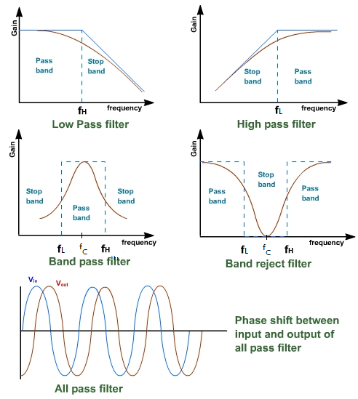
Active Filters

Slide 66
Active Filters
A filter that provides a constant output from dc up to a cut-off frequency f_{H} and then passes no signal above that frequency is called an ideal low-pass filter.
A filter that provides or passes signals above a cutoff frequency f_{L} is a high-pass filter, as shown in previous slide.
When the filter circuit passes signals that are above one ideal cutoff frequency (f_{L}) and below a second cutoff frequency, (f_{H}) it is called a bandpass filter.
Two types of filters
First Order Filter – One capacitor used
Second Order Filter – Two or more capacitor used

Slide 67
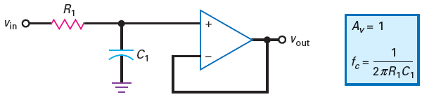
Active Filters- Low-pass filter
Non-Inverting unity gain
It is nothing more than an RC lag circuit and a voltage follower. The voltage gain is: Av = 1.
When the frequency increases above the cutoff frequency, the capacitive reactance decreases and reduces the noninverting input voltage.
Since the R1C1 lag circuit is outside the feedback loop, the output voltage rolls off. As the frequency approaches infinity, the capacitor becomes a short and there is zero input voltage.

Slide 68
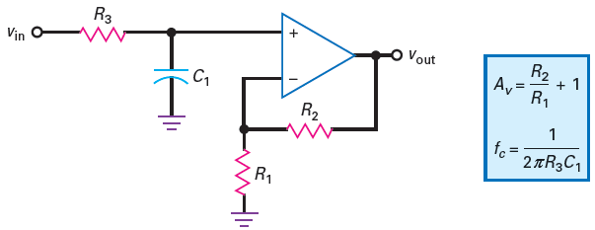
Active Filters- Low-pass filter
Non-Inverting with voltage gain
Although it has two additional resistors, it has the advantage of voltage gain.

Slide 69
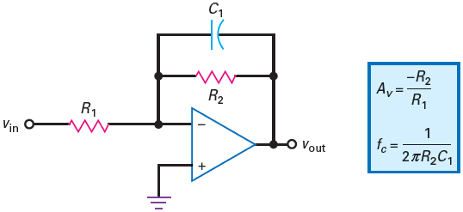
Active Filters- Low-pass filter
Inverting with voltage gain
As the frequency increases, the capacitive reactance decreases and reduces the impedance of the feedback branch. This implies less voltage gain.
As the frequency approaches infinity, the capacitor becomes a short and there is no voltage gain.

Slide 70
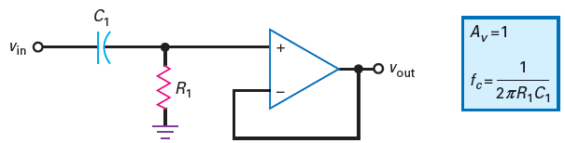
Active Filters- High-pass filter
Non inverting unity gain
When the frequency decreases below the cutoff frequency, the capacitive reactance increases and reduces the noninverting input voltage.
Since the R1C1 circuit is outside the feedback loop, the output voltage rolls off. As the frequency approaches zero, the capacitor becomes an open and there is zero input voltage.

Slide 71
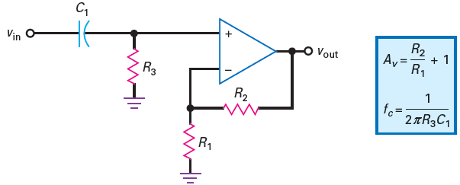
Active Filters- High-pass filter
Non-Inverting with voltage gain

Slide 72
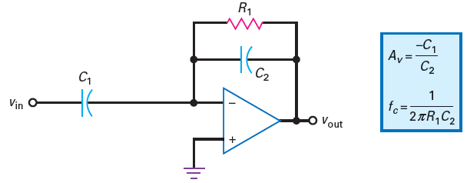
Active Filters- High-pass filter
Inverting with voltage gain

Slide 73

Active Filters- Second Order Filter Low Pass/High Pass Filter
Generalized form of second order filter
If Z1=Z2=R and Z3=Z4=C get second order low pass filter
If Z1=Z2=C and Z3=Z4=R get second order high pass filter

Slide 74
Active Filters- Band-pass Filter
Two types of band pass filter
Wide band pass filter
Narrow band pass filter

Slide 75


Active Filters- Band-pass Filter
Wide Band Pass Filters
Cascade of low-pass and high-pass filter

Slide 76

Active Filters- Band-pass Filter
Narrow Band Pass Filters
In the circuit the input signal goes to the inverting input rather than the noninverting input. Also the circuit has two feedback paths, one through a capacitor and another through a resistor.

Slide 77

Non-Linear Amplifier
In this amplifier the gain value is non-linear function of the amplitude of the input signal.
The gain may be large for weak signal and very small for large signal this can achieved using non-linear device such as PN junction diode as shown below. Also called log amplifier.

Slide 78
Non-Linear Amplifier
Working:
For small value of input signal, diodes act as open circuit and the gain is high due to minimum feedback.
When the amplitude of input signal is large, diodes offer very small resistance and thus gain is low.

Slide 79


Relaxation Oscillator

Slide 80
Relaxation Oscillator
In circuit, there is no input signal.
Nevertheless, the circuit produces a rectangular output signal. This output is a square wave that swings between –Vsat and +Vsat. How is this possible?
Assume that the output is in positive saturation. Because of feedback resistor R, the capacitor will charge exponentially toward +Vsat, as shown in waveform. But the capacitor voltage never reaches +Vsat because the voltage crosses the UTP. When this happens, the output square wave switches to –Vsat.
With the output now in negative saturation, the capacitor discharges, as shown in waveform. When the capacitor voltage crosses through zero, the capacitor starts charging negatively toward –Vsat. When the capacitor voltage crosses the LTP, the output square wave switches back to +Vsat. The cycle then repeats.

Slide 81


Current-To-Voltage Converter
Also called transimpedance amplifier
Consider the simple Op-Amp circuit to convert I to V, as shown in the following Figure.

Slide 82

Voltage-To-Current Converter
Also called transconductance amplifier
For a single input, the current in the load resistor is given by I_{L} = I = Vin/R. from this equation it is obvious that the output current I_{L} is independent of load resistance and is proportional to the input voltage. This is because of the virtual ground at the inverting input terminal of the op-amp.

Slide 83

VOLTAGE REGULATORS :Introduction
Power supply: a group of circuits that convert the standard ac voltage (120 V, 60 Hz) provided by the wall outlet to constant dc voltage
Transformer : a device that step up or step down the ac voltage provided by the wall outlet to a desired amplitude through the action of a magnetic field
.

Slide 84
VOLTAGE REGULATORS :Introduction
Rectifier: a diode circuits that converts the ac input voltage to a pulsating dc voltage
The pulsating dc voltage is only suitable to be used as a battery charger, but not good enough to be used as a dc power supply in a radio, stereo system, computer and so on.
Filter: a circuit used to reduce the fluctuation in the rectified output voltage or ripple. This provides a steadier dc voltage.
Regulator: a circuit used to produces a constant dc output voltage by reducing the ripple to negligible amount. One part of power supply.

Slide 85
VOLTAGE REGULATORS :Introduction
Voltage regulation is the process of keeping a voltage steady under conditions of changing applied voltage, changing load and temperature.
There are two types of voltage regulators: shunt and series.
NEED FOR REGULATORS
A voltage regulator is used for two reasons:-
To regulate or vary the output voltage of the circuit.
To keep the output voltage constant at the desired value in-spite of variations in the supply voltage or in the load current.

Slide 86

VOLTAGE REGULATORS: Factors Affecting the Load Voltage:

Slide 87

VOLTAGE REGULATORS: Performance Parameters of a Power Supply:

Slide 88

VOLTAGE REGULATORS: Performance Parameters of a Power Supply:

Slide 89

VOLTAGE REGULATORS: Types of Regulator
The series regulator is connected in series with the load
The shunt regulator is connected in parallel with the load.

Slide 90

VOLTAGE REGULATORS: Series Regulator Circuit
Control element in series with load between input and output.
Output sample circuit senses a change in output voltage.
Error detector compares sample voltage with reference voltage → causes control element to compensate in order to maintain a constant output voltage

Slide 91

VOLTAGE REGULATORS: Series Regulator Circuit
The unregulated input voltage provides current to the load.
Some of the current is pulled away by the control element.
If the load voltage tries to change due to a change in the load resistance, the sampling circuit provides a feedback signal to a comparator.
The resulting difference voltage then provides a control signal to vary the amount of the current shunted away from the load to maintain the regulated output voltage across the load.

Slide 92
D to A and A to D converter
WHY A to D?
Real world signal appear in analog form
Difficult to process, transmit, store in physical form
Computer perform operation quickly , efficiently
Development in digital technology
WHY D to A?
Computer need to communicate with physical processes , people

Slide 93

Typical A/D and D/A Converter

Slide 94
Typical A/D and D/A Converter
Obtain analog signal from sensor or transducer
Using anti aliasing filter restrict bandwidth of the signal
Sample the signal at a frequency rate more than twice maximum frequency of band limited frequency
Hold sampled signal using hold circuit during conversion

Slide 95
Typical A/D and D/A Converter
Feed the discrete signal to A to D Converter
A to D Converter converts the signal to digital signal
Digital signal is converted to analog signal using D to A Converter
Output of D to A Converter is stair case waveform
Stair case waveform is passed through smoothing filter to remove quantized noise

Slide 96


Basic DAC Techniques

Slide 97

Performance Parameters of DAC
Resolution:
Ratio of change in output voltage resulting from a change of LSB at the digital input.
Resolution = V_{OFS}/2^{n} – 1
V₀ = Resolution x b
Accuracy
Measure of how close the actual output voltage is to the theoretical output value

Slide 98
Performance Parameters of DAC
Setting Time:
Setting time is the time required for a DAC output to settle within ± 1/2 LSB of final value for a given digital input.
Stability:
The performance of a DAC is not stable due to the parameters such as temperature, power supply variations, and ageing.

Slide 99

Binary Weighted Resistor DAC
When the switch is ON : 𝐼= 𝑉_{𝑅}/𝑅
When the switch is OFF : I = 0.

Slide 100


Binary Weighted Resistor DAC
total current through R_{f}
𝐼= 𝐼₁+ 𝐼₂+ 𝐼₃+ …+ 𝐼_{𝑛}

Slide 101
Drawbacks of DAC
Large range of resistor values are required, as resistance values increases like 2¹R, 2²R, 2³R, . . . , 2^{n}R.
Practically it’s difficult to fabricate large values of resistors on IC.

Slide 102

R-2R Ladder type DAC
Due to virtual ground, both the positions of the switches are at ground potential, and currents through the resistances are constant.

Slide 103

R-2R Ladder type DAC

Slide 104
R-2R Ladder type DAC : Advantages
As it requires only two types of resistors, fabrication and accurate value of R-@R can be designed.
Node voltage remains constant, and hence, slow down effect can be avoided.

Slide 105


Slide 106


Slide 107


Slide 108


Slide 109

A-D Converters
Types: Direct type ADCs and Integrated type ADCs

Slide 110

Flash (Comparator/ Parallel) type ADC:
2-bit Flash ADC

Slide 111

Flash (Comparator/ Parallel) type ADC:
2-bit Flash ADC

Slide 112

3-bit Flash ADC

Slide 113

3-bit Flash ADC

Slide 114
Flash (Comparator/ Parallel) type ADC:
Advantages:
High speed
Disadvantages:
Number of comparators required is almost double for each added bit
Eg.: For 2-bit ADC; No. of Comparators = 4 (22) For 3-bit ADC; No. of Comparators = 8 (23)

Slide 115

Successive Approximation type ADC

Slide 116

Successive Approximation type ADC

Slide 117
Successive Approximation type ADC
The conversion time for n-bit successive approximation ADC is (n + 2) clock periods.
Advantages:
Considerably good speed
Good resolution.

